Slide 1
SOFTWARE REQUIREMENTS ENGINEERING
INTRODUCTION
26th March, 2013
Engr. Ali Javed

Slide 2
Presentation Outline
What is Requirement? Software Requirements Sources of Requirements
The Goal of Software Development
Stakeholder’s Environment Customer’s Types
Root Causes of Project Success and Failures
The Frequency of Requirement Errors The High Cost of Requirement Errors Requirements Management
Types of Software Applications Types of Software Requirements The Problem Domain
The Solution Domain
❑
❑
❑
❑
❑
❑
❑
❑
❑
❑
❑
❑
❑

Slide 3

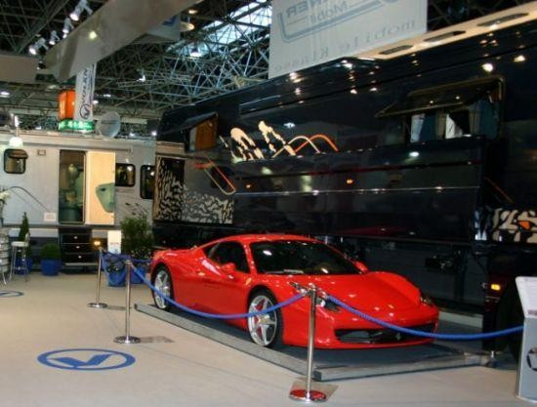
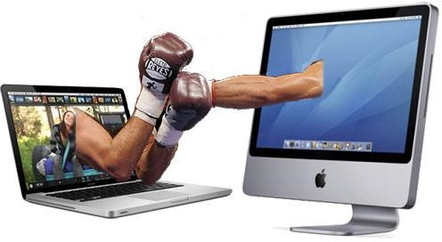
Requirement
8
Something required, something wanted or needed
Webster’s dictionary
There is a huge difference between wanted and needed and it should be kept
in mind all the time
Need- something you have to have
Want -something you would like to have

Slide 4

Software Requirements
9
A complete description of what the software system will do without describing how it will do it is represented by the software requirements
Software requirements are complete specification of the desired external behavior
of the software system to be built
Software requirements may be:
🗸 Abstract statements of services
🗸 Detailed mathematical functions
🗸 Part of the bid of contract
🗸 The contract itself
🗸 Part of the technical document, which describes a product
Response of software against the input

Slide 5
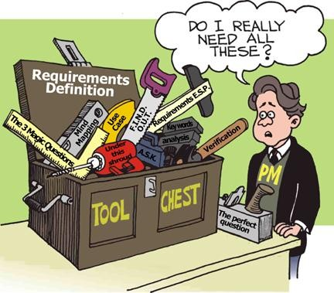
Requirement
10
Can be constraint
functionality
A condition or capability that must be met or possessed by a system...to satisfy a contract, standard, specification, or other formally imposed document
🞑 IEEE Std 729

Slide 6

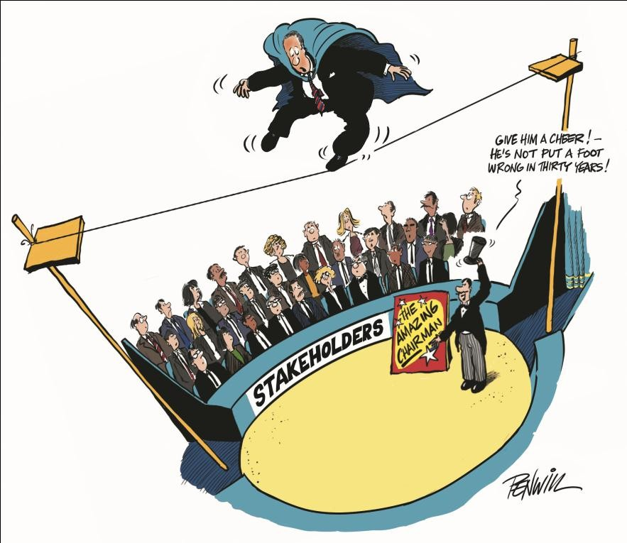

Sources of Requirement
11
Stakeholders
🗸 People affected way by the system
Documents

Slide 7

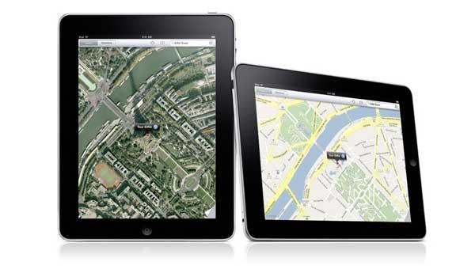
Sources of Requirement
12
Existing system
Application Domain

Slide 8
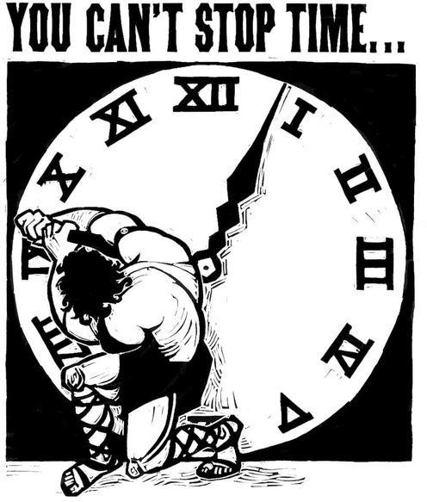
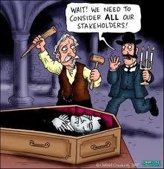
The Goal of Software Development
13
The goal of software development is to develop quality software—on time and on budget—that meets customers' real needs.
A software is good if it MEETS STAKEHOLDERS EXPECTATIONS:
it is (at least) correct, reliable, maintainable, user- friendly …
the total cost it incurs over all phases of its life cycle is
minimal and within the budget

Slide 9
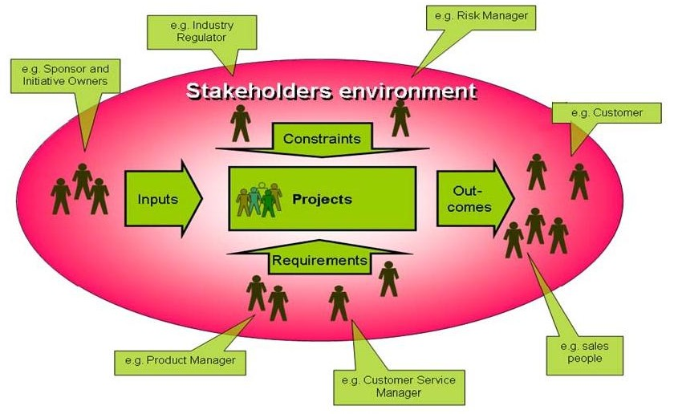
Context: Stakeholder's Environment
14

Slide 10
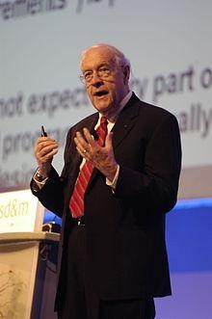

Importance of Software Requirements
15
The hardest single part of building a software system is deciding what to build….. No other part of the work so cripples the resulting system if done wrong. No other part is difficult to rectify later. (Fred Brooks)

Slide 11
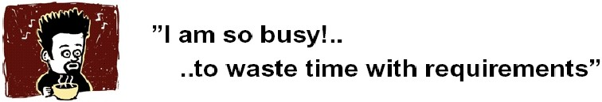
The Root Causes of Project Success and Failure
16
The first step in resolving any problem is to understand the root causes.
The 1994 Standish Group survey study noted the most three commonly cited factors that caused projects to be "challenged":
Lack of user input: 13 percent of all projects
Incomplete requirements and specifications: 12 percent of all projects
Changing requirements and specifications: 12 percent of all projects

Slide 12

The Root Causes of Project Success and Failure
Thereafter, the data diverges rapidly. Of course, your project could fail
because of an unrealistic schedule or time frame (4 percent of the projects this),
inadequate staffing and resources (6 percent),
inadequate technology skills (7 percent), or various other reasons.
cited
The survey shows that at least a third of development projects run into trouble for reasons that are directly related to requirements gathering, requirements documentation, and requirements management.

Slide 13

The Root Causes of Project Success and Failure
18
Although the majority of projects do seem to experience schedule/budget overruns, the Standish Group found that 9 percent of the projects in large companies were delivered on time and on budget; 16 percent of the projects in small companies enjoyed a similar success. That leads to an obvious question: What were the primary "success factors" for those projects?
According to the Standish study, the three most important factors were
User involvement: 16 percent of all successful projects

Slide 14
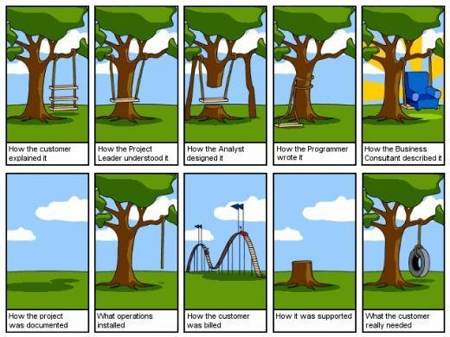
The Root Causes of Project Success and Failure[1]
🗸 Executive management support: 14 percent of all successful projects
🗸 Clear statement of requirements: 12 percent of all successful projects

Slide 15
Frequency of Requirement Errors
20
Table 1. summarizes a
1994 study by Capers Jones that provides
data regarding the likely number of "potential" defects in a
development project and the typical "efficiency" with which a
development organization removes those defects through various combinations of testing, inspections, and other strategies.
Table 1. Defect Summary
DefectOrigins | Defect Potentials | Removal Efficiency | Delivered Defects
Requirements | 1.00 | 77% | 0.23
Design | 1.25 | 85% | 0.19
Coding | 1.75 | 95% | 0.09
Documentation | 0.60 | 80% | 0.12
Bad fixes | 0.40 | 70% | 0.12
Total | 5.00 | 85% | 0.75
Requirements errors top the delivered defects and contribute approximately one third of the total delivered defects to the defect pile

Slide 16
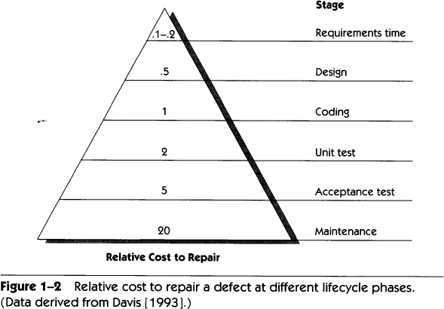
High Cost of Requirement Errors
21
If a unit cost of one is assigned to the effort required to
detect and repair an error during the coding stage ….

Slide 17
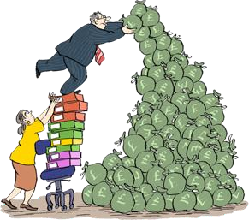
High Cost of Requirement Errors
22
The errors discovered during the design of a development project could
fall into one of two categories:
🗸 errors that occurred when the development staff created a technical design from a correct set of requirements or
🗸 errors that should have been detected as requirements errors somewhat earlier in the process but that somehow "leaked" into the design phase of the project.

Slide 18
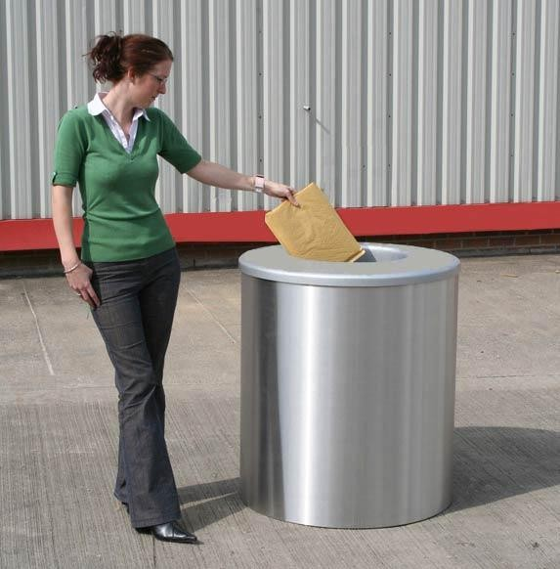
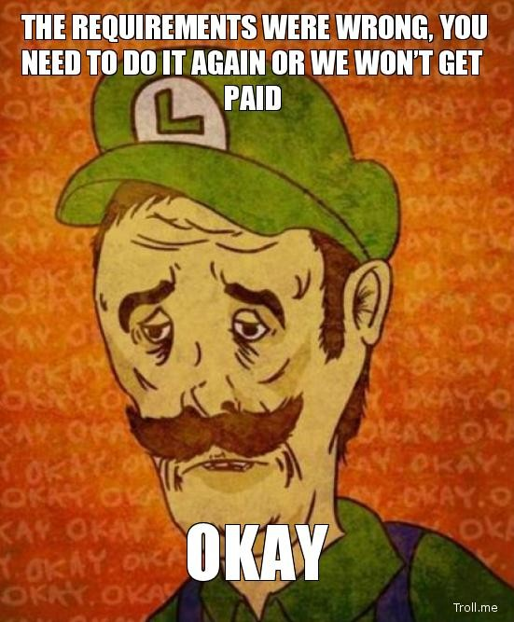
High Cost of Requirement Errors
23
It's the latter category of errors that turn out to be particularly expensive, for two reasons.
By the time the requirements-oriented error is discovered, the development group will have invested time and effort in building a design from those erroneous requirements. As a result, the design will probably have to be thrown away or reworked.
The true nature of the error may be disguised; everyone assumes that they're looking for design errors during the testing or inspection activities that take place during this phase, and considerable time and effort may be wasted until someone says, "Wait a minute! This isn't a design mistake after all; we've got the wrong requirements.―

Slide 19
High Cost of Requirement Errors- Defect Leakage
24
One organization that has done the research on defect leakage is Hughes Aircraft. A study by Snyder and Shumate [1992] follows the leakage phenomenon for a large collection of projects Hughes has conducted over the past 15 years.
The study indicates that
Defects discovered
at Requirements Analysis phase-- 74 percent of the
requirements-oriented defects
Defects discovered at preliminary, or high-level, design-- 4 percent of the
requirements defects "leak" and that 7 percent leak further into detailed design.
The leakage continues throughout the lifecycle, and a total of 4 percent of the
has
requirements errors aren't found until maintenance, when the system
been released to the customers and is likely in full-scale operation.

Slide 20
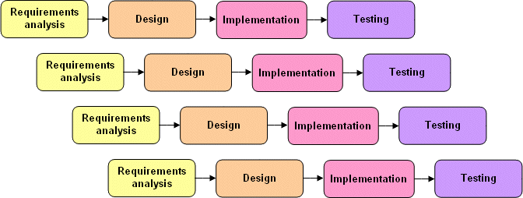


High Cost of Requirement Errors- Defect Leakage
25
whenever a defect is discovered in a software application, we're
likely to experience the effect of 50–100 times cost.
🗸 Re-specification.
🗸 Redesign.
🗸 Recoding.
🗸 Retesting.
🗸 Change orders
🗸 Corrective action

Slide 21
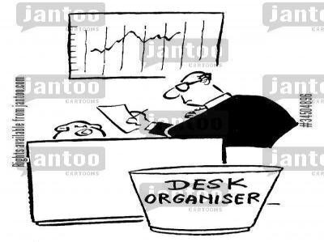



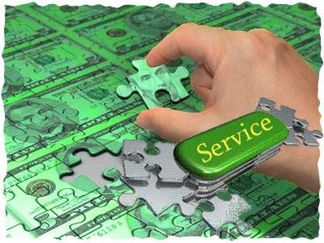
High Cost of Requirement Errors- Defect Leakage
26
🗸 Scrap
🗸 Recall of defective versions of software and associated manuals from users.
🗸 Warranty costs.
🗸 Product liability
🗸 Service costs for a company representative to visit a customer's field location to reinstall the new software.
🗸 Documentation

Slide 22
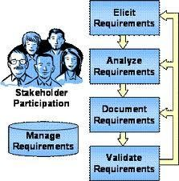
Requirements Engineering Process
27
Elicitation: work with the customer on gathering
requirements
Analysis: process this information to understand it, classify in various categories, and relate the customer needs to possible software requirements
Specification: Structure the customer input and derived requirements as written documents and diagrams
Validation: you’ll ask your customer to confirm that what you’ve written is accurate and complete and to correct errors.

Slide 23
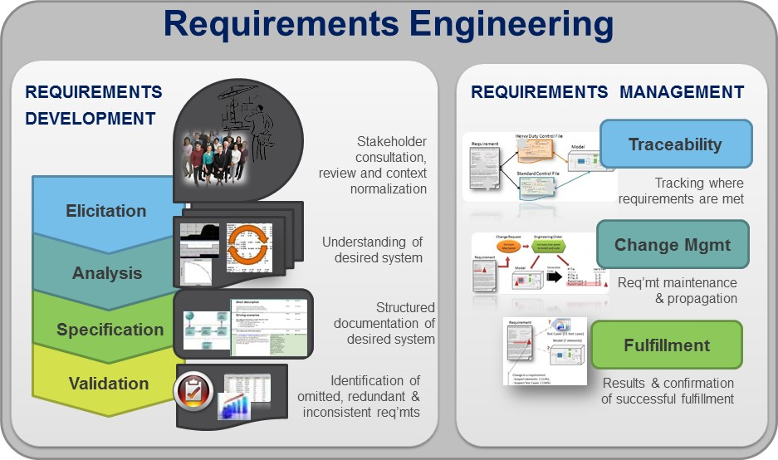
Requirements Management
28
Requirements management is the process of documenting, analyzing, tracing, prioritizing and agreeing on requirements and then controlling change and communicating to relevant stakeholders.

Slide 24
Types of Software Apps
29
Information Systems
Commercial Software Apps
Embedded Systems

Slide 25
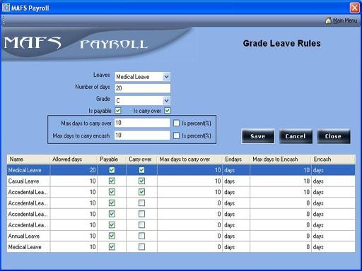
Types of Software Applications
30
Information Systems
Information systems and other applications developed for use within a company (such as the payroll system being used to calculate the take-home pay for our next paycheck). This category is the basis for the information system/information technology industry, or IS/IT.

Slide 26


Types of Software Applications
31
Commercial Software Applications
Software developed and sold as commercial products (such as the MS Office). Companies developing this type of software are often referred to as independent software vendors, or ISVs.

Slide 27
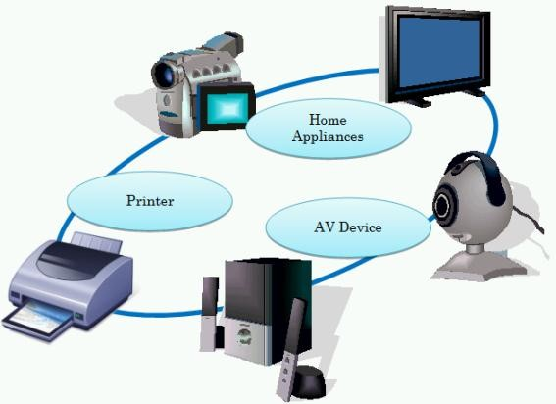
Types of Software Applications
32
Embedded Software's
Software that runs on computers embedded in other devices, machines, or complex systems (such as those contained in the airplane, in cell phones, in washing machines, in ovens, the automobile and many more…….) This type of software's are known as software embedded-systems applications, or embedded applications.

